Slide 1
DEVELOPMENT OF A PREDICTIVE MAINTENANCE SYSTEM FOR TURBOFAN JET ENGINES USING REAL-TIME ANOMALY DETECTION AND PERFORMANCE MONITORING
DANIEL MADUIKE
10TH OF MARCH 2025

Slide 2
INTRODUCTION
Turbofan jet engines are very valuable in aviation because they are the core power source of modern aircraft and generate the thrust needed for flight. These engines operate at extreme conditions like high temperature, high pressure, and constant mechanical stress. Therefore, they require frequent maintenance to ensure reliability and safety of the aircraft and its passengers.

Slide 3
PROBLEM STATEMENT
Engine breakdowns result in costly emergency repairs, flight delays, flight cancellations, and potential safety risk to passengers and the flight crew. Aviation companies formerly relied on reactive and scheduled maintenance strategies to prevent this. However, these strategies are not optimal because in reactive maintenance, repairs only occur after a breakdown, and in scheduled maintenance, repairs occur at fixed schedules whether necessary or not, incurring more cost of operations.

Slide 4
PREDICTIVE MAINTENANCE
Predictive maintenance is a maintenance strategy where AI/Machine Learning models are employed to analyse engine sensor data to predict when a failure will occur. This ensures that maintenance occurs only when it is needed. This approach is better because -
Reduces maintenance costs.
Prevents operational downtime
Improves flight safety.
Systems developed using a particular industry can be scaled to other industries.

Slide 5
RESEARCH OBJECTIVES
Design and implement machine learning and deep learning algorithms to predict the remaining useful life (RUL) for the turbofan jet engines using the CMAPSS dataset.
To effectively handle sensor noise, which was a major limitation from the previous literature, to improve the performance of the machine learning and deep learning models.
Determine the most effective model for the RUL prediction and anomaly detection.
Validate the model performances by comparing the results across two sets of the dataset (FD001 and FD004) from the CMAPSS dataset.
Evaluate the performance of the machine learning models using statistical methods, which include r2 score, root mean square error and mean absolute error.

Slide 6
THE DATASET
The CMAPSS dataset (Commercial Modular Aero-Propulsion System Simulation) is a widely used benchmark for predictive maintenance, developed by NASA. It contains time-series sensor data (FD001 – FD004) collected from jet engines operating under different conditions, tracking their degradation over time until failure. Each row in the dataset represents one operational cycle of an engine.
FEATURES
Cycle index
Time (cycles)
3 operational settings
21 sensor readings
RUL

Slide 7
DATA SUMMARY
Dataset | Number of Engines | Operating Conditions | Failure Modes | Rows | Columns
FD001 | 100 | 1 | 1 (HPC Degradation) | 20,631 | 26
FD002 | 259 | 6 | 2 (HPC & Fan Degradation) | 53,075 | 26
FD003 | 100 | 1 | 1 (HPT Degradation) | 24,198 | 26
FD004 | 248 | 6 | 2 (HPT & Fan Degradation) | 61,249 | 26
Operating conditions: Altitude, Mach number, Temperature, Throttle Setting, Fuel Flow Rate, and Operational Profile.

Slide 8
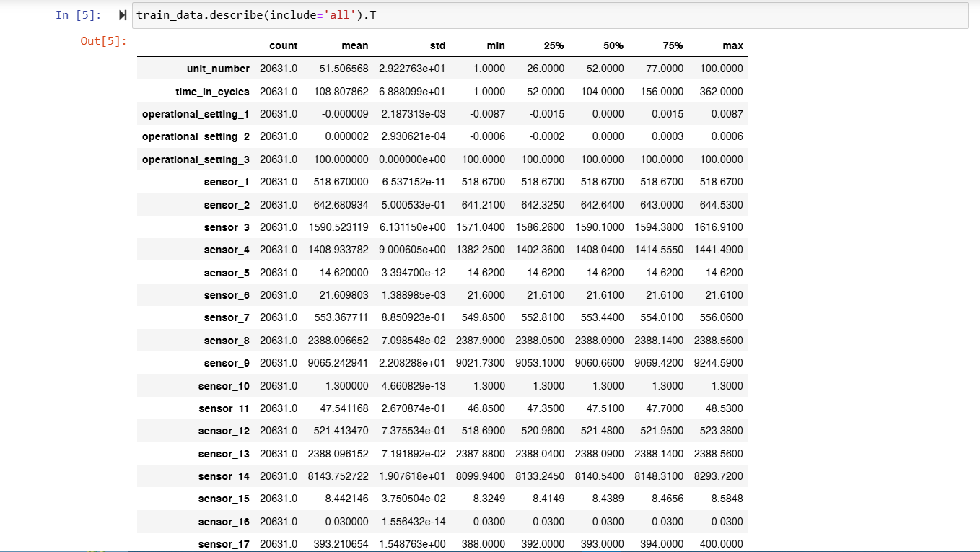
DATASET STATISTICAL SUMMARY

Slide 9
METHODOLOGY (PROCESSES)
The processes employed in achieving the objectives of this research include –
Data Preprocessing
Feature selection
Normalisation
Noise Reduction (EMA Smoothing, EMA span = 5)
Model Training
Used train-test split (70-30%) to evaluate models.
Fine-tuned hyperparameters like learning rate, batch size, and dropout rate.
Used Adam optimiser & Mean Squared Error (MSE) loss function for training.

Slide 10
METHODOLOGY (MODELS)
The following machine learning and deep learning models were employed in this research -
Linear regression
Random forest
Extreme gradient boost (XGBoost)
Artificial neural network (ANN)
Convolutional neural network (CNN)
Long short-term memory (LSTM)
Hybrid model (ANN and CNN)

Slide 11
METRICS OF EVALUATION
The metrics used to evaluate the performance of the models in this research are -
Mean square error (MSE)
Root mean square error (RMSE)
Mean absolute error (MAE)

Slide 12
RESULTS FROM DATASET FD001
MODEL | MSE | RMSE | MAE
LINEAR REGRESSION | 2.19 | 1.48 | 0.80
RANDOM FOREST | 0.33 | 0.57 | 0.02
XGBOOST | 0.14 | 0.38 | 0.01
ANN | 2.65 | 1.63 | 0.99
CNN | 13.96 | 3.74 | 2.50
LSTM | 25.52 | 5.05 | 4.02
HYBRID MODEL | 2.59 | 1.61 | 1.11

Slide 13
RESULTS FROM DATASET FD004
MODEL | MSE | RMSE | MAE
LINEAR REGRESSION | 3.71 | 1.93 | 0.87
RANDOM FOREST | 0.10 | 0.31 | 0.01
XGBOOST | 1.05 | 1.03 | 0.08
ANN | 2.77 | 1.66 | 0.84
CNN | 4.50 | 2.12 | 1.37
LSTM | 29.54 | 5.43 | 4.63
HYBRID MODEL | 3.45 | 1.86 | 1.09

Slide 14
RESULTS DISCUSSION
For the machine learning and deep learning models developed for the first dataset FD001 of the turbofan jet engine remaining useful life, the general models performed well on training and evaluation, with the machine learning model XGBoost regressor being the best-performing model with 0.38 RMSE.
After the XGBoost regressor, the random forest regressor was the next best performing model with a RMSE of 0.57.
For the modeling of the second dataset FD004, the random forest regressor was the best performing model with a RMSE score of 0.31 followed by XGBoost as the second-best model with a score of 1.03.
From this research, the classical machine learning models were better suited for the prediction of the remaining useful life (RUL) than the deep learning models.

Slide 15
LIMITATIONS ENCOUNTERED
Lack of a large dataset for training, which made the deep learning models struggle.
Computational expenses when training deep learning models
The need for domain knowledge for data preprocessing.
Noise in the sensor data.
Lack of a real-world practical dataset due to privacy guidelines, as the CMAPPS was a simulated dataset.

Slide 16
FUTURE RECOMMENDATION
It would be beneficial to use Graphics Processing Unit (GPU) computational training resources such as the NVIDIA RTX compute system in future studies.
Extend the study to real-world aircraft maintenance datasets beyond CMAPSS (simulated).
Explore advanced hybrid models, integrating LSTM and Transformer architectures for time-series forecasting.

Slide 17
THANK YOU

